Slide 1
Vendor C-CDA to FHIR mapping review and alignment

Slide 2
Worked Through with Vendors
(in May ballot)

Slide 3
Allergy

Slide 4
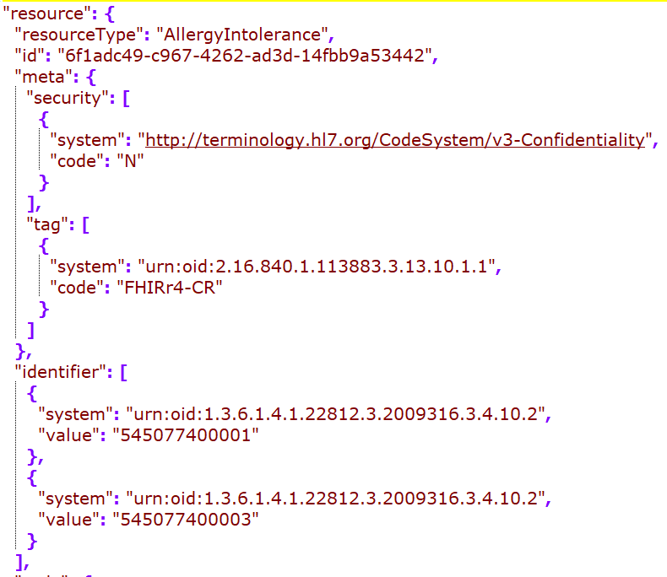
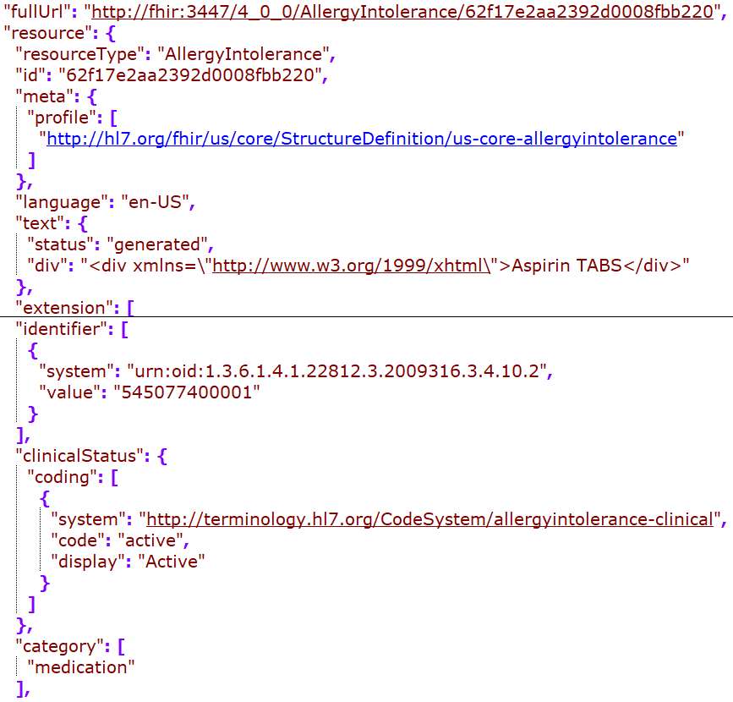
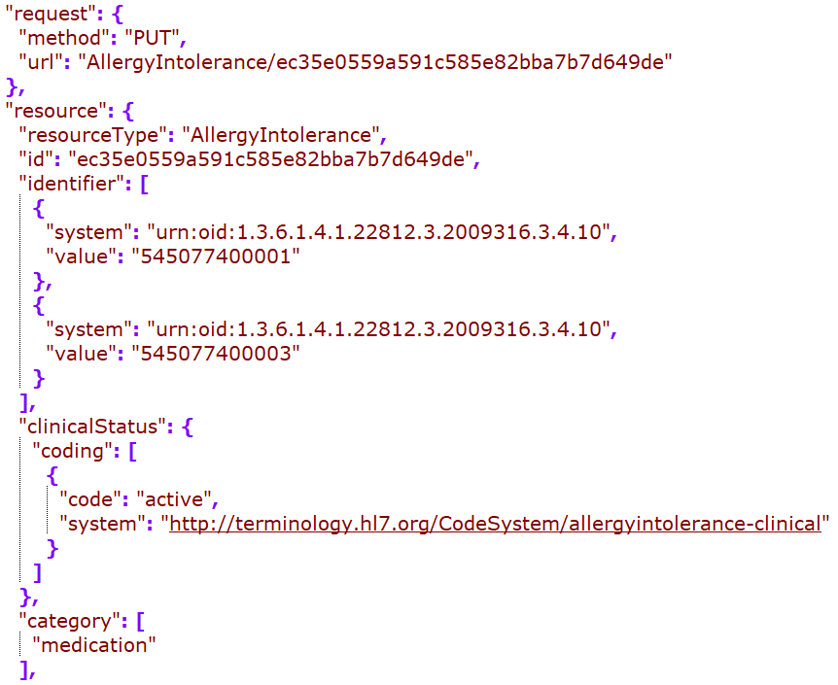
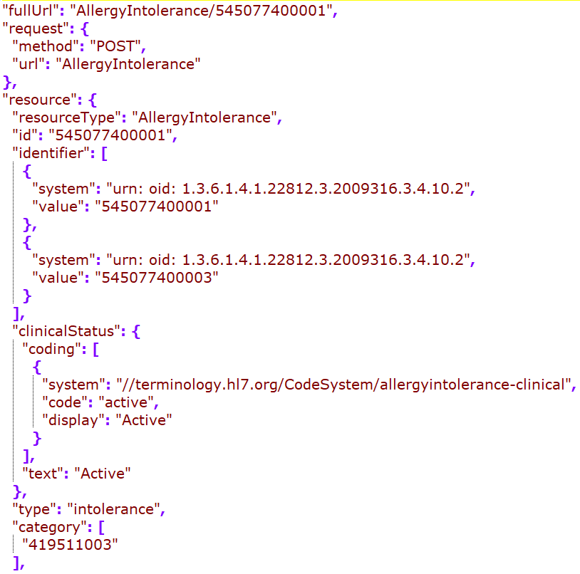
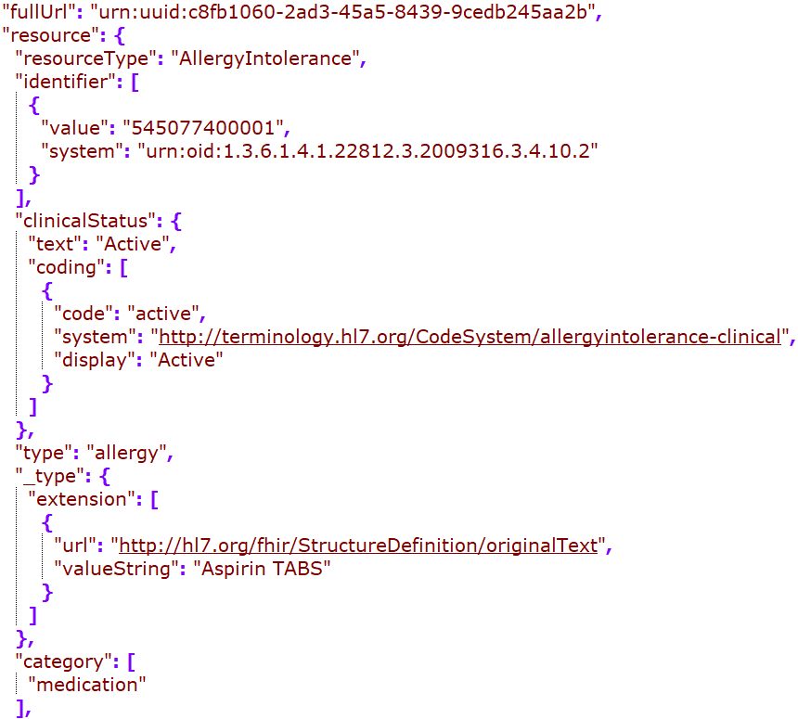
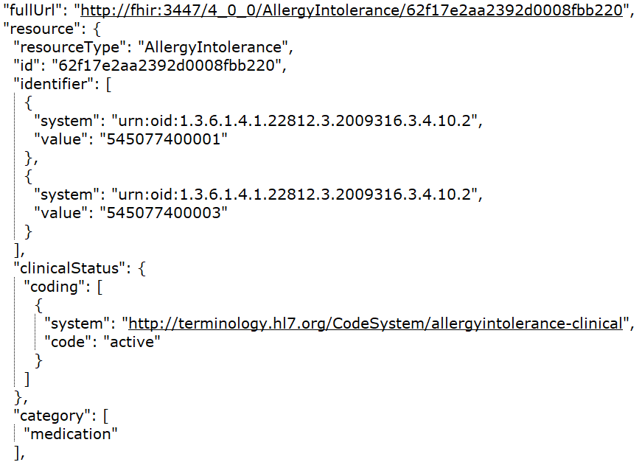
Cerner
DH
Google
MDIX
Redox
Rec in JSONC

Slide 5
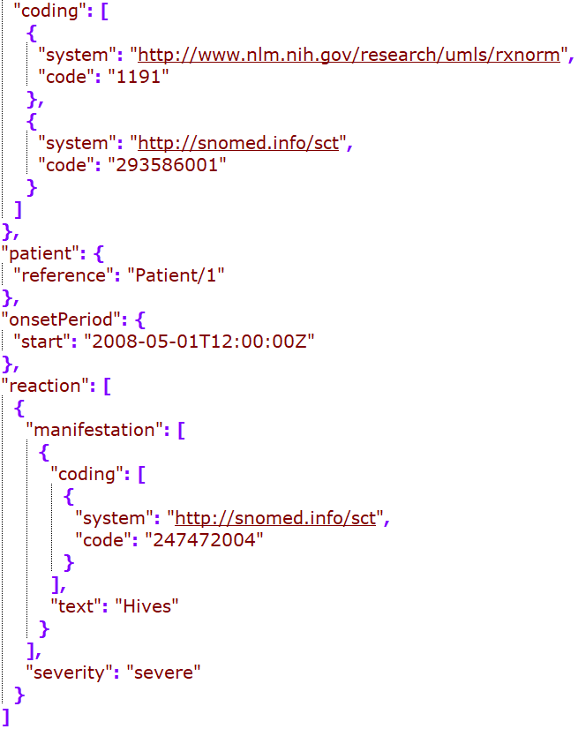
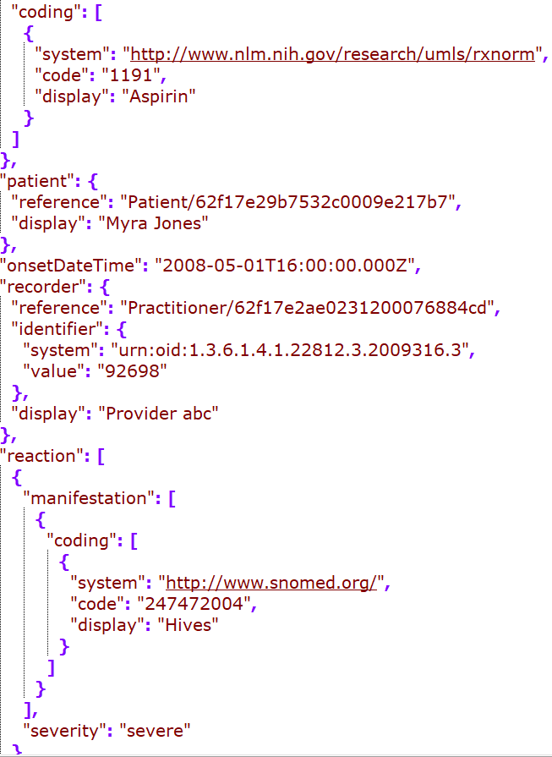
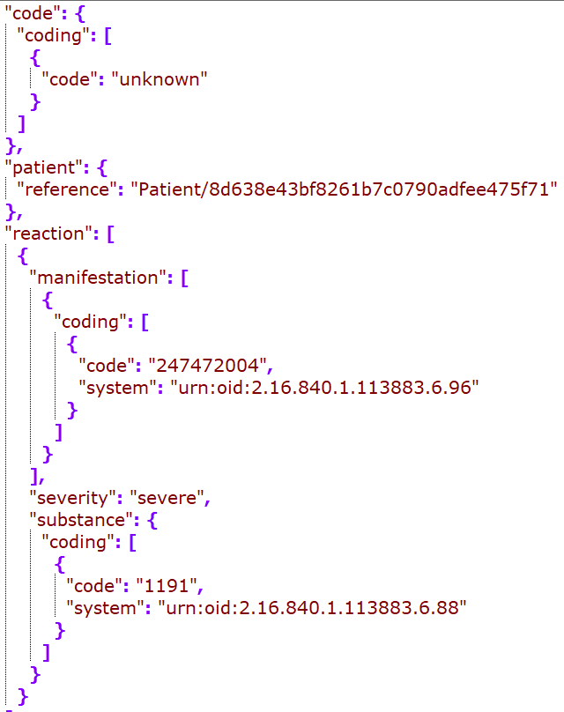
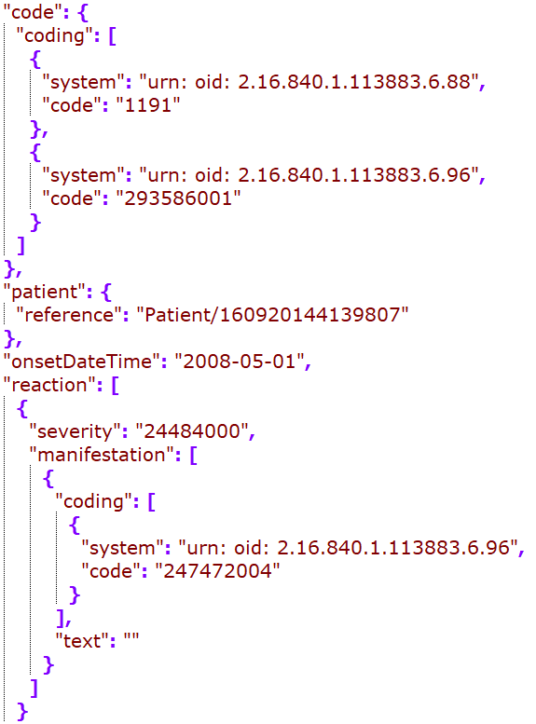
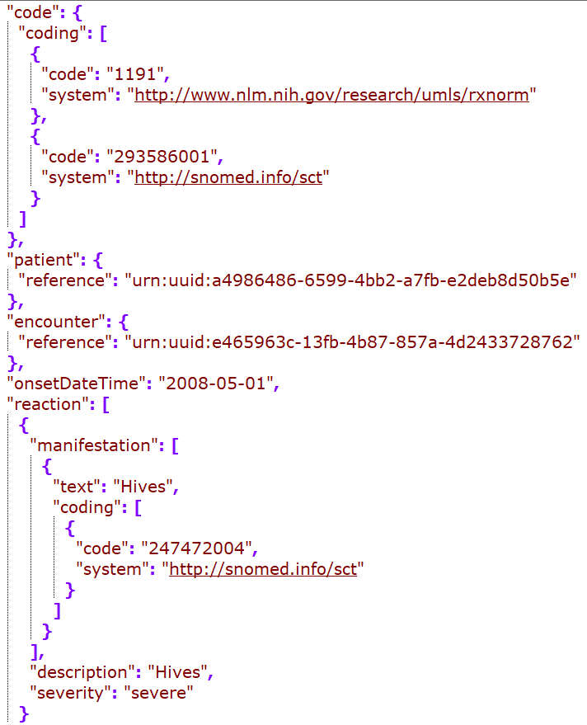
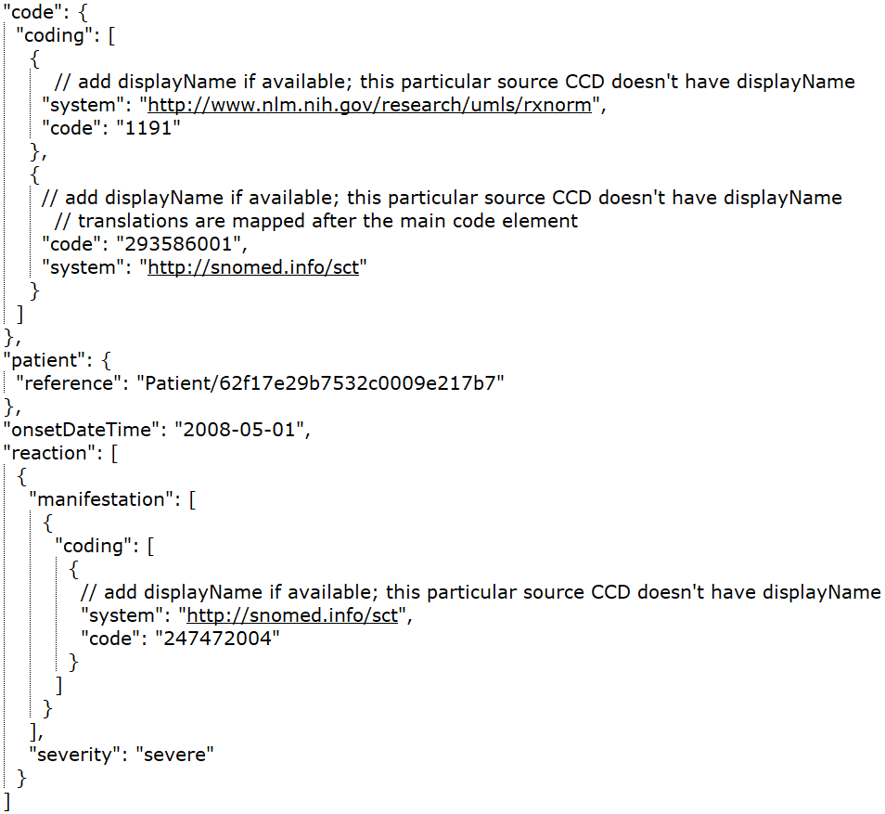
Cerner
DH
Google
MDIX
Redox
Rec – in JSONC

Slide 6
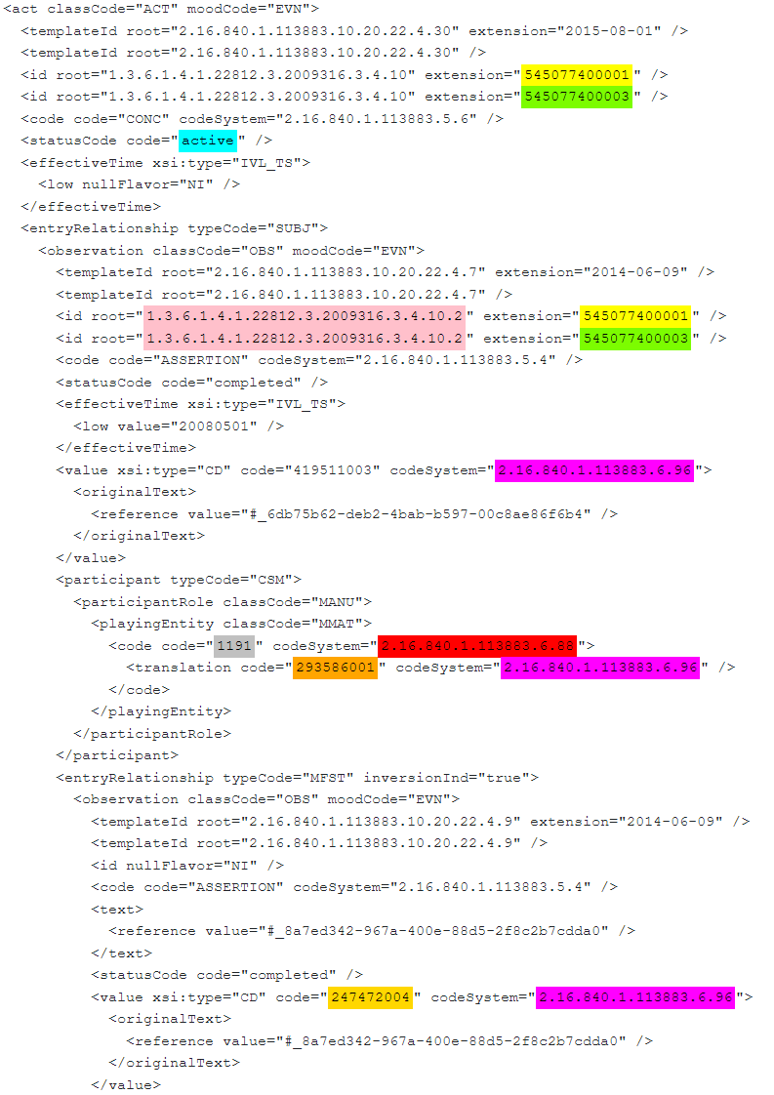
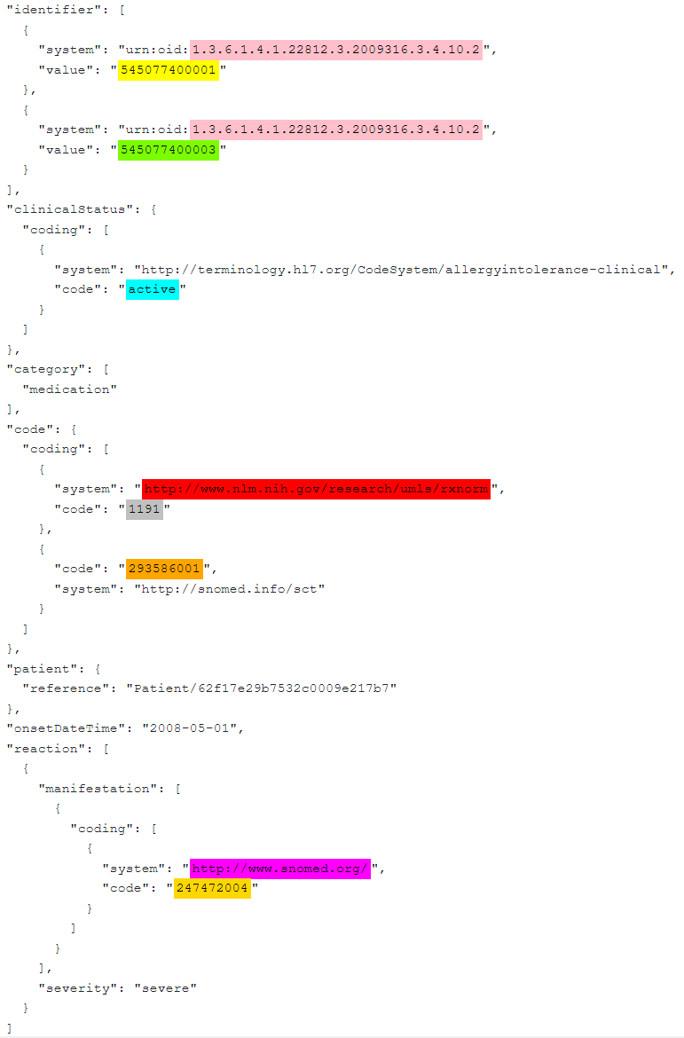
CCD – Allergy snippet
FHIR – Allergy snippet

Slide 7
Immunization

Slide 8
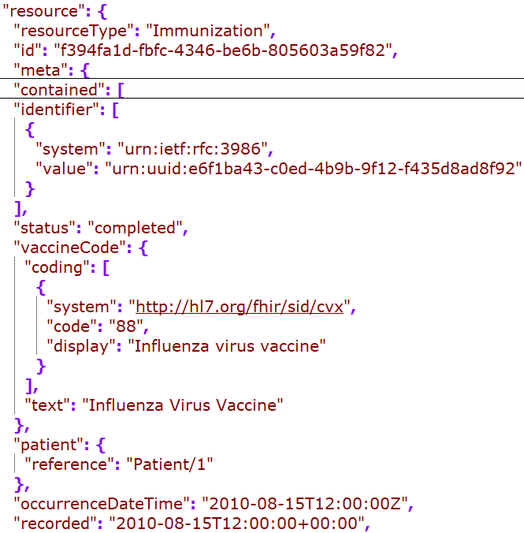
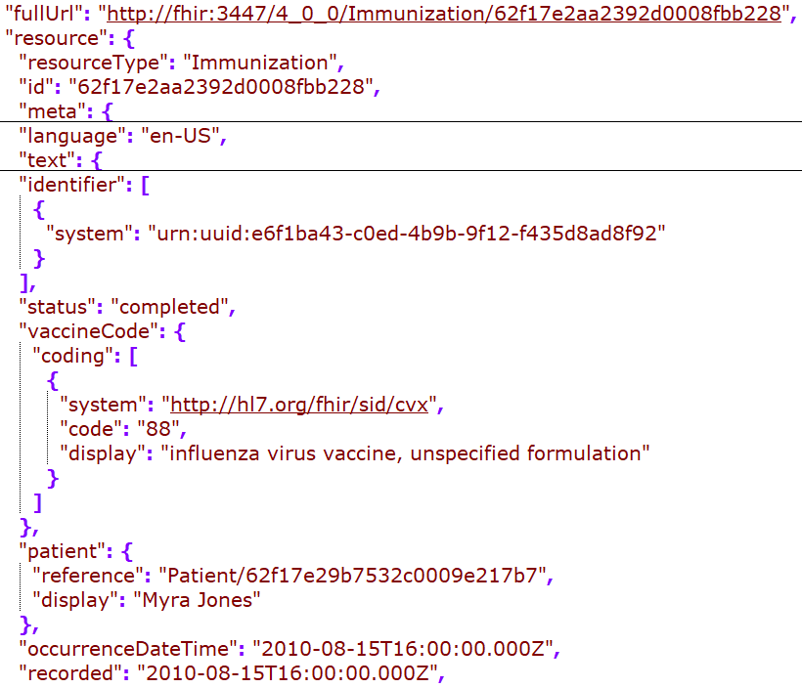
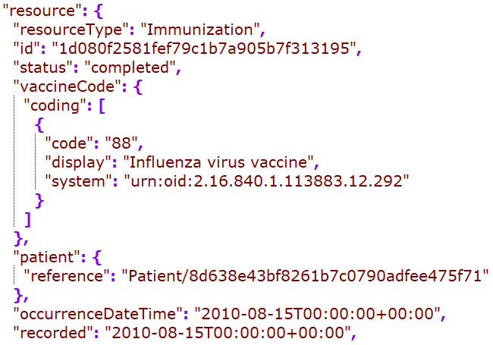
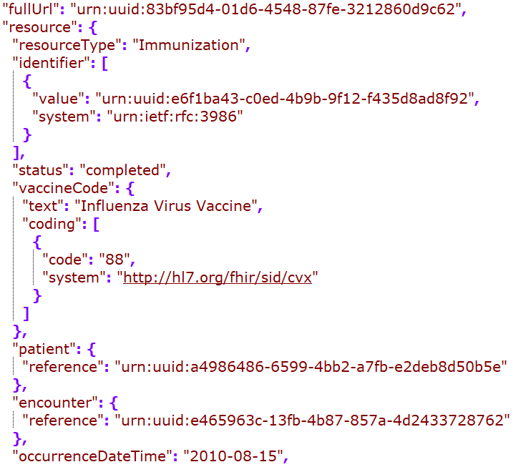
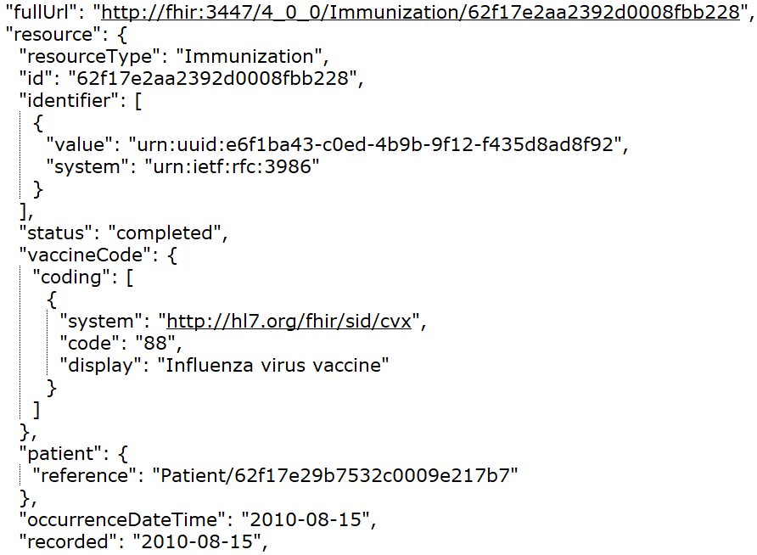
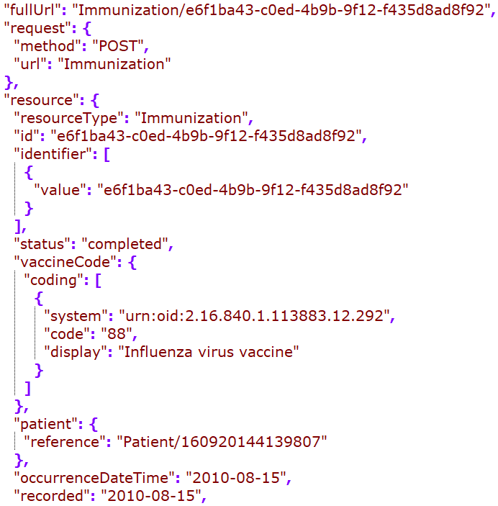
Cerner
DH
Google
MDIX
Redox
Rec – in JSONC

Slide 9
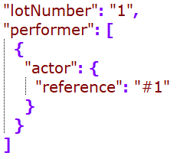
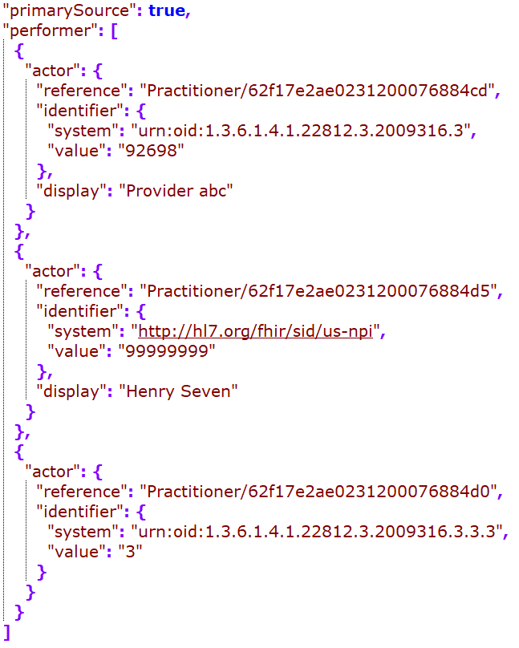
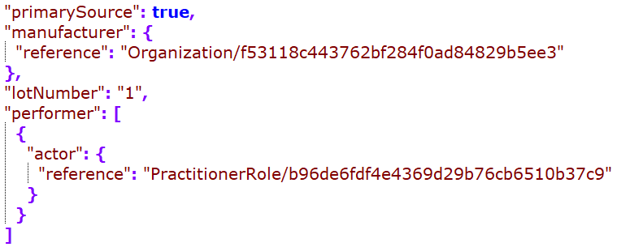
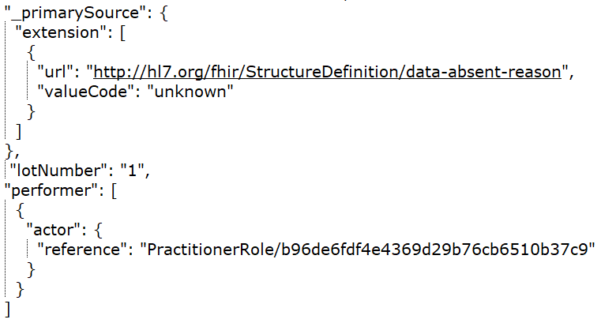
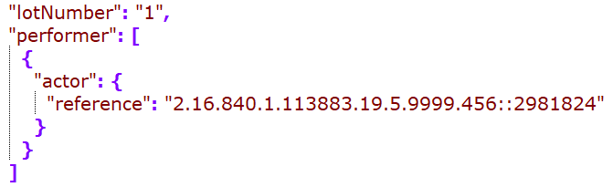
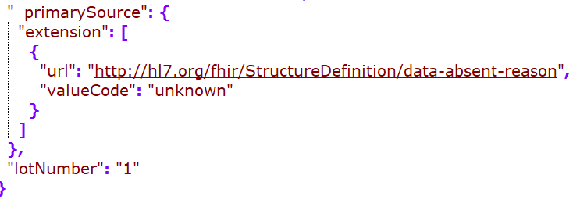
Cerner
DH
Google
Rec – in JSONC
MDIX
Redox

Slide 10
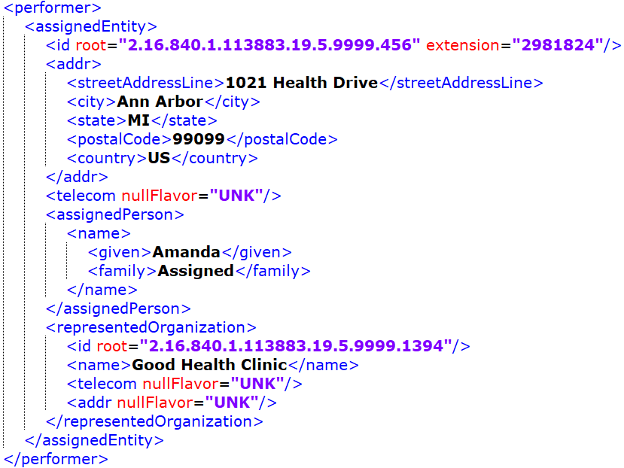
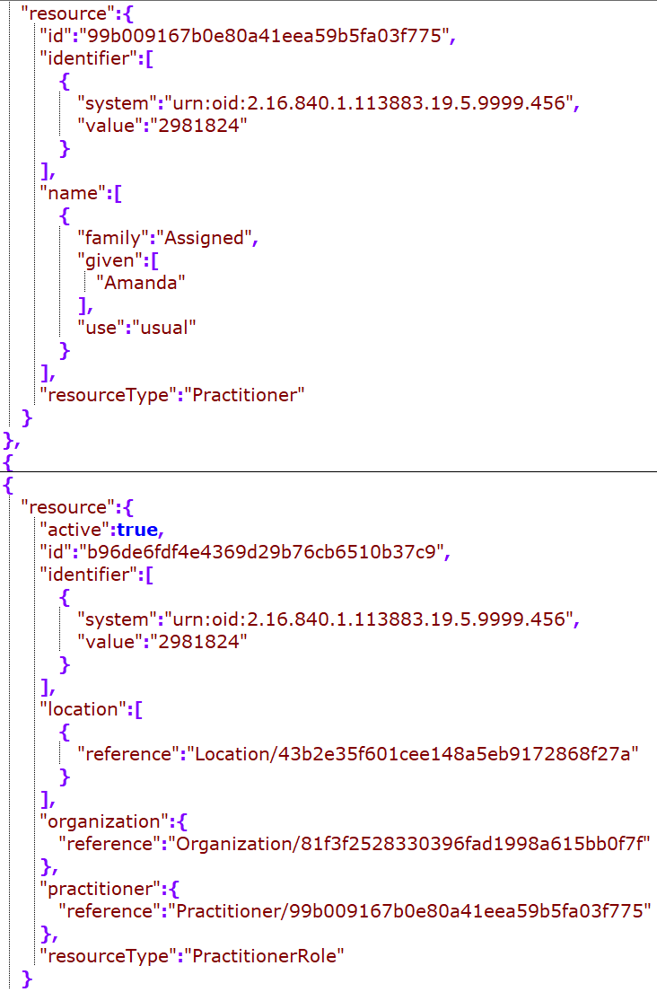
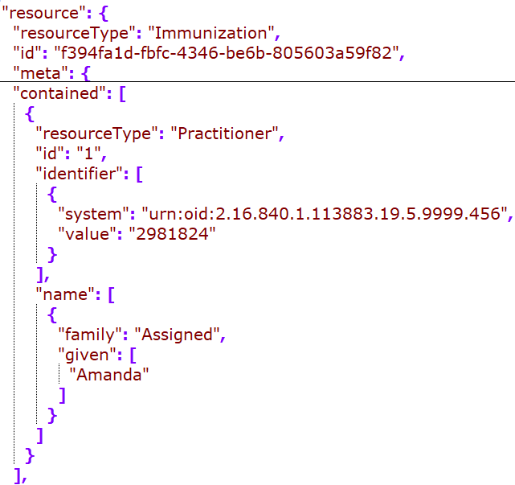
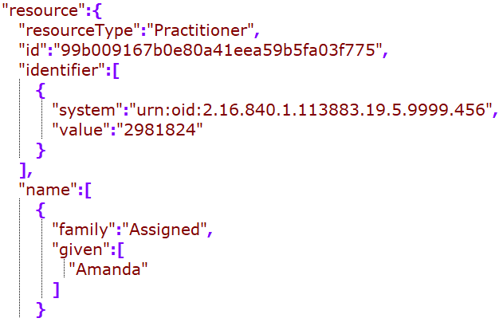
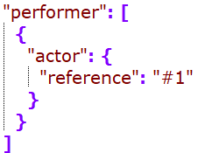
Practitioner (Immunization Performer)
Cerner: embedded in the clinical entry/ resource
Google: standalone resource
MDIX: didn’t find a match – should we recommend to resolve a reference within a composition?
Cerner/Google:
standalone vs embedded?
Practitioner or practionerRole as the direct reference

Slide 11
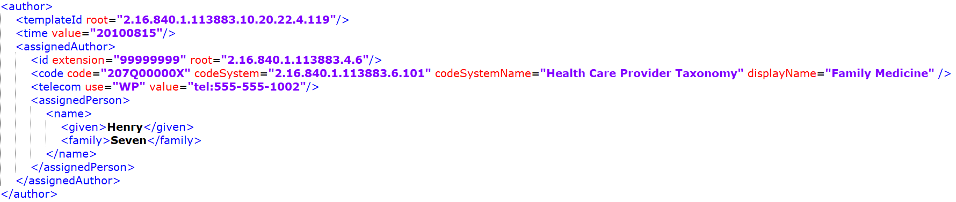
While performer is picked up by some, the author seems to be dropped from all mappings…
Since there is not “recorder” for the immunization resource, this could be mapped to provenance.

Slide 12
Patient

Slide 13
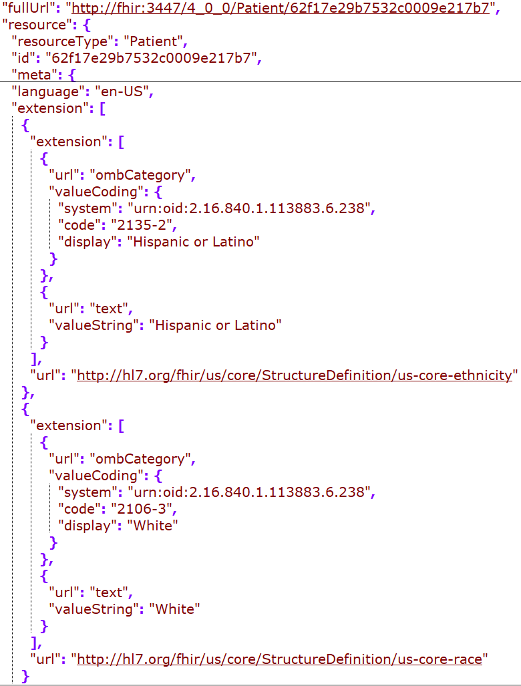
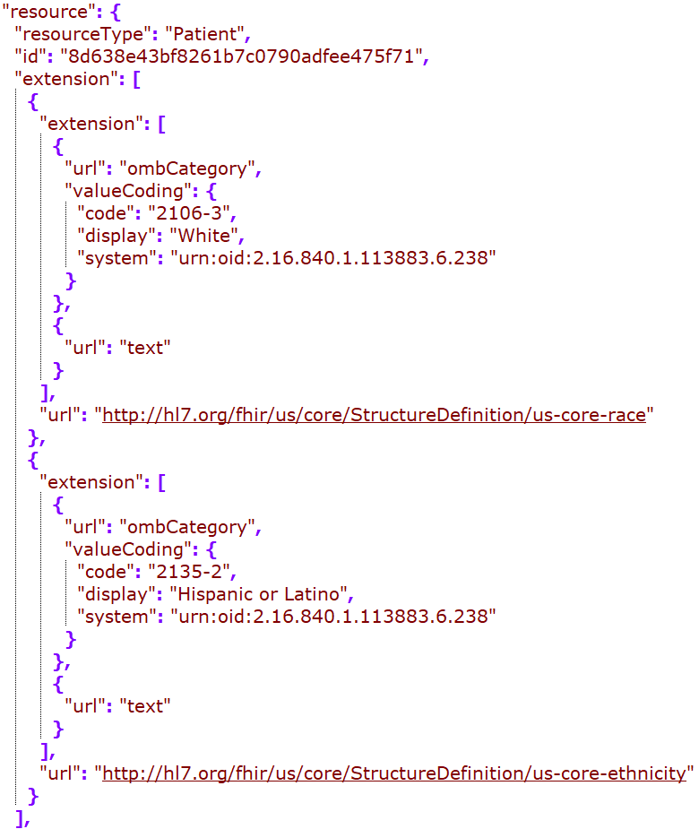
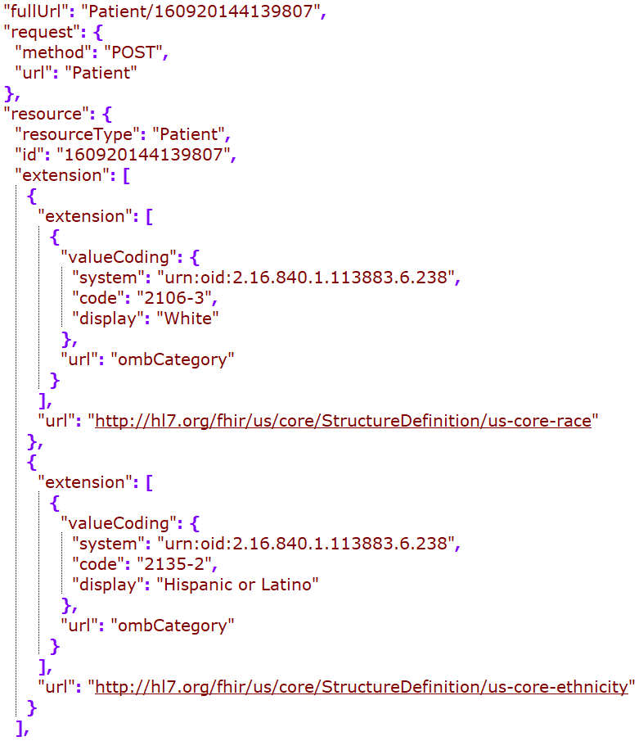
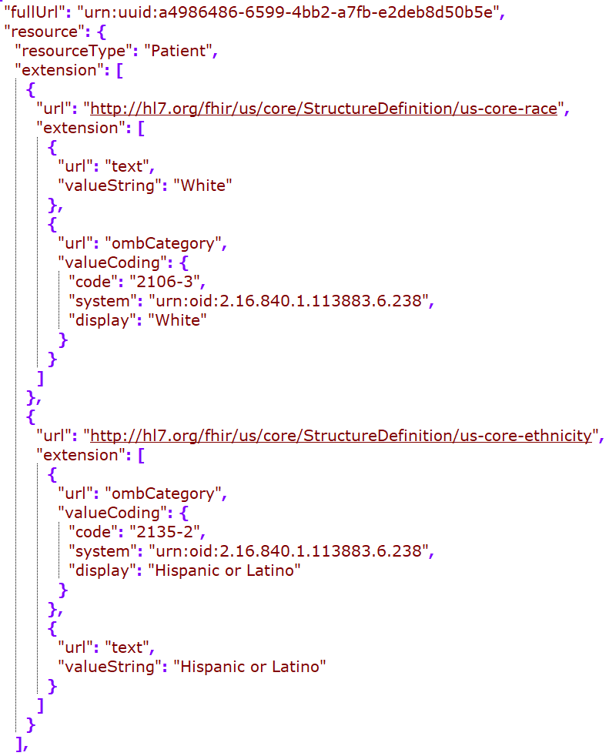
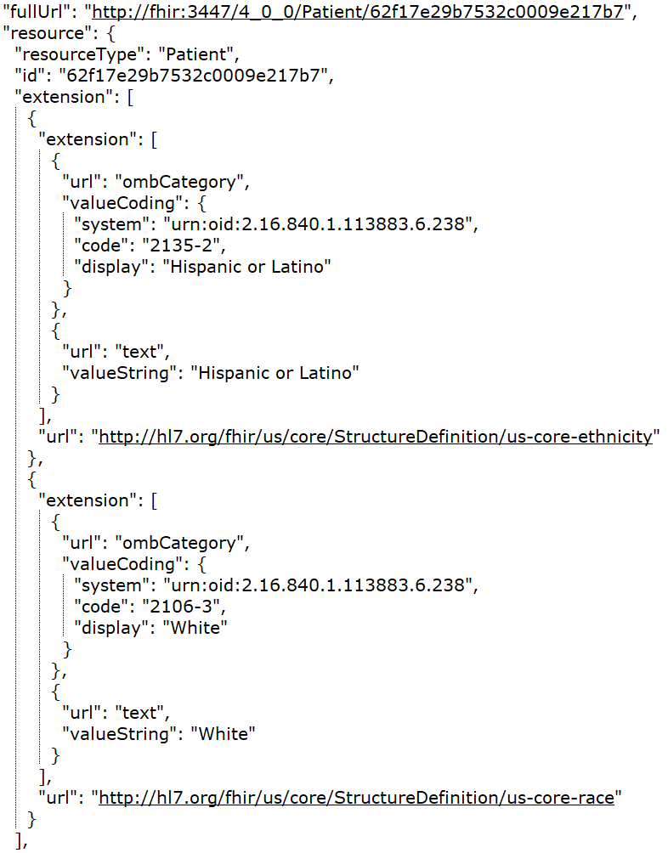
DH
Google
MDIX
Redox
Rec – in JSONC

Slide 14
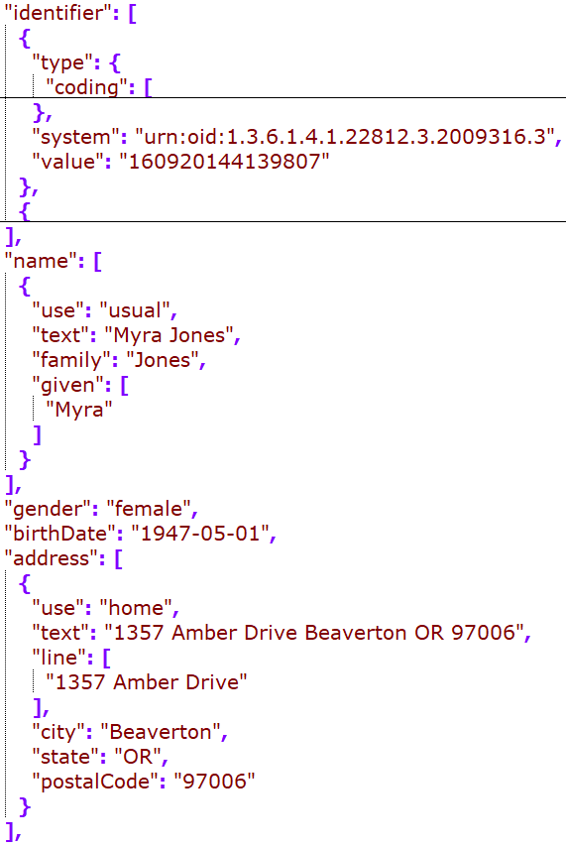
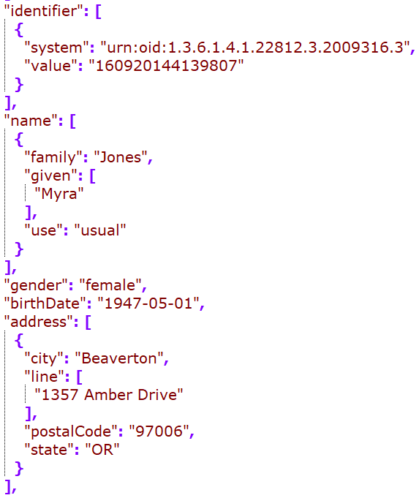
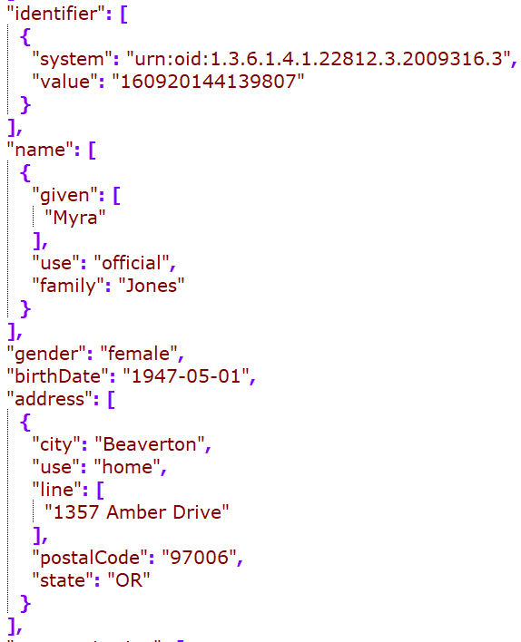
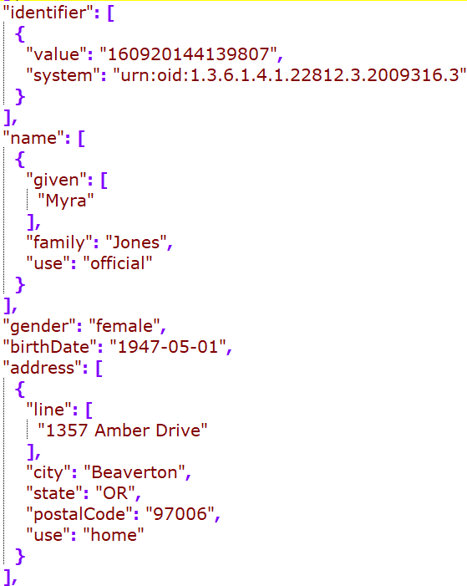
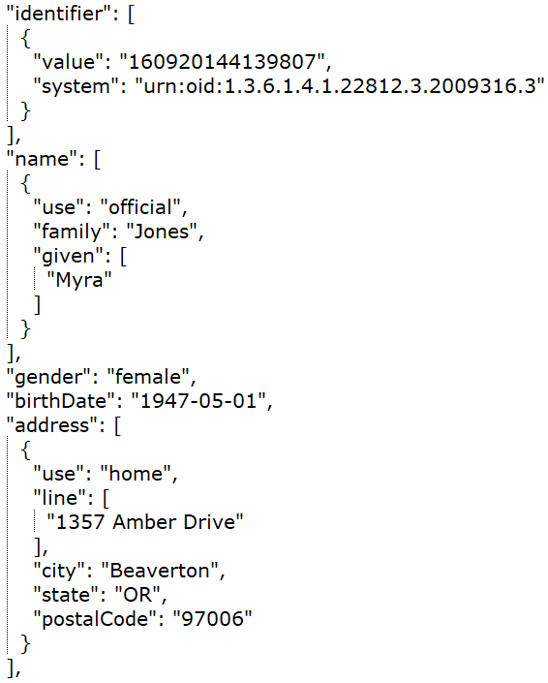
DH
Google
MDIX
Redox
Rec – in JSONC

Slide 15
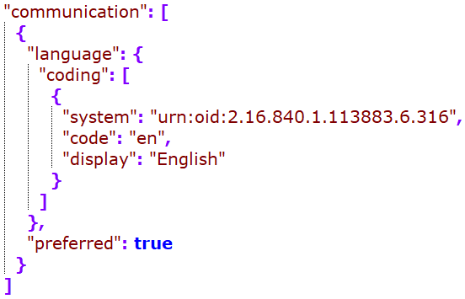
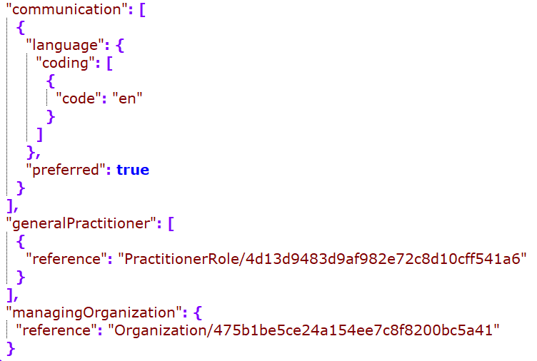
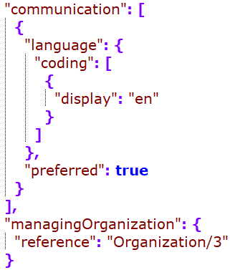
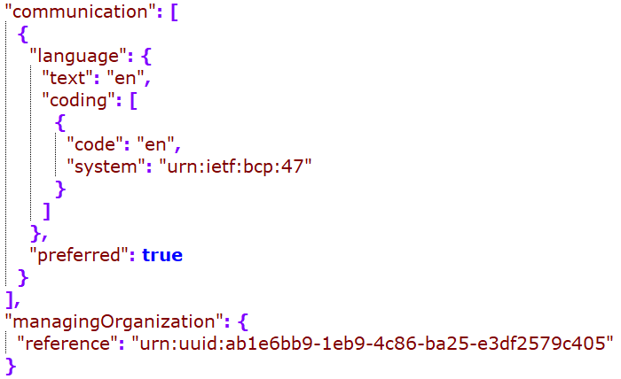
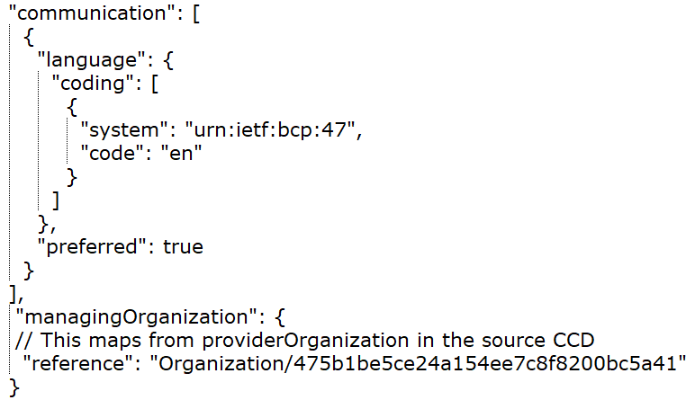
DH
Google
MDIX
Redox
Rec – in JSONC

Slide 16
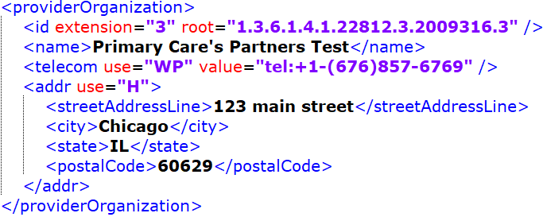
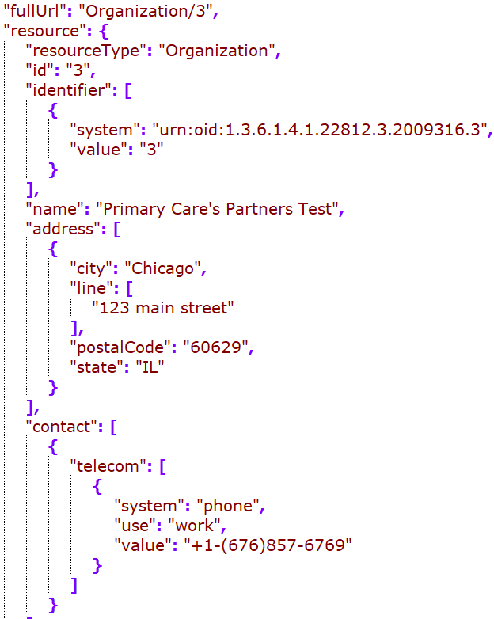
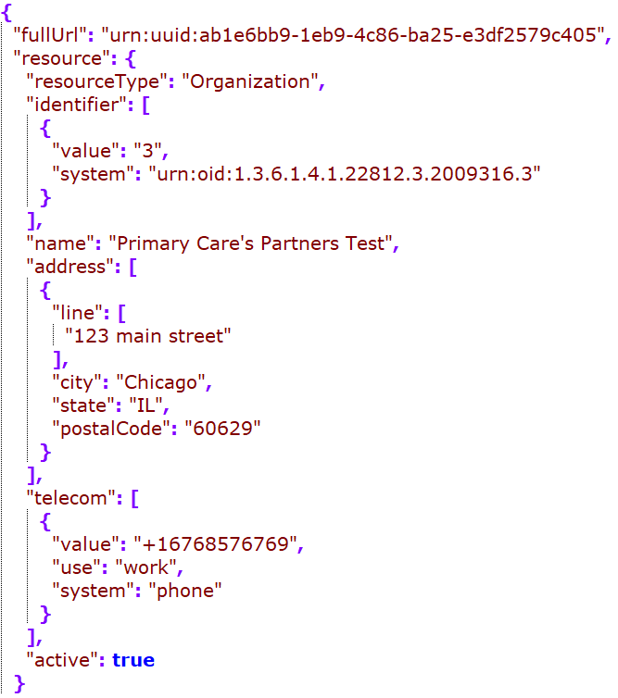


Organization (providerOrganization)
Google
MDIX
Redox
Rec

Slide 17
Problem

Slide 18






Cerner
DH
Google
Rec – in JSONC
MDIX
Redox
Notes:
Id dedupe?
Category including the actual code (a retired SNOMED code for problem), or problem-list-item (looks like this is required)

Slide 19






Cerner
DH
Google
MDIX
Redox
Rec – in JSONC
Notes:
Observation timestamp – mapped to onsetDateTime or onsetPeriod.start
Map the act timestamp?

Slide 20
Medication -
Mapping to medicationRequest for all medication entries
May also map to other medication resources as needed, but the map is out of scope of this project
The following slide compared medicationRequest mapping

Slide 21



Cerner
DH
Rec

Slide 22
Outstanding Questions as of 12/21/2022
Medication mapping by moodCode
Practitioner or practionerRole as the direct reference
practionerRole should be the direct reference
When not available, use the practitioner
Creating practitionerRole only when the practitioner has a code, or the data has an organization and a person
Organization: telecom format
FHIR examples have all different formats, all numbers, with parathesis, beginning plus signs, etc. may want to go with minimal manipulation? Detect the type and use that to direct where to go for FHIR data attributes and map the rest of the strings.
“mailto”: email, fax: - fax, sms: - sms, tel: - phone (or if use="PG", then "pager")
If none of the above and it contains a “@”, map to “email”
Otherwise, map to “phone” with the string as is
Nullflavors mapping
standalone vs embedded – recommending standalone
Best practice is to include resultable reference in the composition – where would this go?
Notes:
Same practitioner in two facilities, one is billable and not; they need to be separate
Organization or code/functionCode needs to be available to map

Slide 23
nullFlavor mapping
nullFlavor from C-CDA to nullFlavor
If it’s required, map to the DAR using Jay’s map
If it’s not required and the flavor is one of UNK, NI, NA, drop it
If it’s not required, there are options. A lot of misuse of nullFlavors in the C-CDA (cite the paper?), choice can be made based on your implementation, trust of the source data quality, etc.
Choices are: drop all; drop when they are one of UNK, NI, NA, and map others using Jay’s map; map all using Jay’s map
Jay’s maps:
https://docs.google.com/spreadsheets/d/1InSFh9f8WILzz4J3IB_QaXQUGNYSiAtOjEtwK3FkswI/edit#gid=827428488
https://docs.google.com/spreadsheets/d/1VWVtLyuQdZq-EZ020nndAIhfAIVjVqAUG-rUhh9ZX2s/edit#gid=0
See updated guidance in the next two slides

Slide 24
nullFlavor mapping - Non-coded data elements
Non-coded data elements map to DAR extensions
Required data elements
Map to the relevant-flavor DAR (using the map)
Use “unknown” DAR if there are no applicable mappings
Optional data elements – options below
Map to relevant DAR; Use “unknown” DAR if mapping is not available
Map to relevant DAR for flavors other than “NI”, “UNK” and “NA”; drop if it’s one of these three
Drop all
Guidance in non-italic font is summarized from: http://hl7.org/fhir/us/core/STU3.1.1/general-guidance.html#missing-data
Guidance in Italic font is from project group’s best practice recommendation

Slide 25
nullFlavor mapping - Coded data elements
Non-coded data elements generally map to DAR code with the DAR URI as codeSystem
Required data elements
Required binding:
Use the appropriate “unknown” concepts in the value set if available
If not available, create a 404 http error if it’s one of the five elements defined by the USCore*
If not available and not one of the given elements above, map to a DAR extension, using Jay’s map
Other binding:
Use code or text if available
If not, map to the DAR code (using the map), and use “unknown” if mapping is not available
Optional data elements – options below
Map to relevant DAR code; Use “unknown” DAR if mapping is not available
Map to relevant DAR code for flavors other than “NI”, “UNK” and “NA”; drop if it’s one of those
Drop all
Guidance in non-italic font is summarized from: http://hl7.org/fhir/us/core/STU3.1.1/general-guidance.html#missing-data
Guidance in Italic font is from project group’s best practice recommendation
* All the 5 elements are statuses, which may be able to be derived from related data elements such as effectiveTime, moodCode, etc.
Notes:
AllergyIntolerance.clinicalStatus
Condition.clinicalStatus
DocumentReference.status
Immunization.status
Goal.lifecycleStatus

Slide 26
Handle mapping the nullFlavor section??
Only required for the required clinical sections
If the section has NI as the nullFlavor, do not map to FHIR resource
No known allergy
https://build.fhir.org/ig/HL7/US-Core/StructureDefinition-us-core-allergyintolerance.html
Available for higher level concepts (class level) – use a concept map if there are no specific allergen code but has an allergy type in the C-CDA
For negation for a specific allergen, no standard way to do on the FHIR side – could ask on Zulip
DH was mapping that to the LOINC code (48767-8) of “annotation” and specific allergen code to the annotation. Comment

Slide 27
General Mapping Recommendations:
For codable concepts, map the originalText from the C-CDA to the coding.text attribute (using the reference link as needed to obtain the actual text before mapping)
For codable concepts with translations, map the translations to coding.code array, following the main entry
For identifier mapping, please refer to https://docs.google.com/spreadsheets/d/1EhRiTh3-wOd6t0eQa2iKD4RQ-A32aqNju1R0rG-afgE/edit#gid=2143847847 for the full mapping logic 4.
Within a bundle, should always try to include resultable reference links

Slide 28
Other Reference Resources in P+PAMI

Slide 29
Procedure

Slide 30






DH
MDIX
Redox
Rec
Google
Notes:
Change to a single value and map to performedDateTime

Slide 31
To Discuss with Vendors
(Not in May ballot)

Slide 32
Result

Slide 33


Source Lab Results entry
Inbound CCD Results Entry

Slide 34


Consensus JSONs: observation and DiagnosticReport
Notes:
Discussion point:
“category” (for both observation and diagnosticReport): to use the LOINC parts to direct the mapping to the category coding; infer from the section (but not everything is going to be laboratory; ask C-CDA to include the guidance)
“issued” for diagnosticReport map from the organizer author time if available. need to pad with the timestamps. otherwise DAR
Performer mapping for observation:
Map if available in the observation level; otherwise leave it out
valueQuantity /reference range mapping:
Map to value and unit. If the unit is UCUM conformant, then also map to system and code.
“issued” for observation: if observation-level author.time is available, map from there; otherwise leave it out (check to make sure it’s after the observation effectiveTime); need to pad with the timestamps
Assumption: organizer-level author.time means the ordered time and likely before or the same with the specimen time

Slide 35
Result - Observation

Slide 36






C
D
G
M
R
Rec
Notes:
ResourceType, identifier, status: same mapping across vendors
Category coding:
map from inbound section template? (most mapped)
Also map the “text” field?
Consensus: to use the LOINC parts to direct the mapping to the category coding; infer from the section (but not everything is going to be laborotary; ask C-CDA to include the guidance)

Slide 37





C
D
G
R
M
Notes:
Cerner/Google/MDIX: how they map results.issued?
From Previous recommendation:
Coding:
Map to http://loinc.org as the system
Map the xml originalText to the “text” field
effectiveDateTime: no need to supplement timestamps
Patient Ref: include display? - no
Encounter ref: include?
”issued”: whether and how to map?
subject: if you have the link to the referenced resource, do not have to include the display; otherwise try to include the display
“issued”: if entry author.time is available, map from there; otherwise leave it out (check to make sure it’s after the onset date); need to pad with the timestamps

Slide 38





C
D
G
M
R
Notes:
Performer mapping:
Map if available in the observation level; otherwise leave it out
valueQuantity mapping:
Map to value and unit. If the unit is UCUM conformant, then also map to system and code.
referenceRange mapping
Map to value and unit. If the unit is UCUM conformant, then also map to system and code.
Need the quantity-precision ext?
Need “text”? Have to resolve the ref link
Recommendation: 1. recommend to FHIR to include precision as a field for the quantity field (quantityPrecision for quantity); 2. in the here and now, include the precision extension

Slide 39
Result - diagnosticReport

Slide 40


D
R
Notes:
ResourceType, status: same
Identifier: DH’s mapping??
Category: whether and how to map? Source LOINC/template?
Code: “display” is missing from source
3 codes: diagnostic imaging, laboratory, clinical, - find the loinc codes

Slide 41


D
R
Notes:
New questions/issues not covered before:
Logic for “issued”
What else to include in the performer, if more than “reference”?
Results reference to also include ”display”?
issued: map from the organizer author time if available. need to pad with the timestamps. otherwise DAR

Slide 42
Vital Sign

Slide 43


Source Vital sign entry

Slide 44


Consensus JSONs: observations for the src observation and organizer
Remove encounter reference for the organizer→observation mapping for consistency
Notes:
organizer:
diagnosticdReport: encounter conduction: for observation (results and vitals): safe to do so – encompassingEncounter
hasMember: link to the individual vital signs
Text.div to extended to include the text from the C-CDA
Observation:
map the single timepoint to the effectiveDateTime; and map the high low to effectivePeriod structure if the low and high are different

Slide 45





C
D
G
M
R
Notes:
ResourceType, identifier, status – same mapping
Category:
map “userSelected”? How? – not going to map
How to map to “text”? – not needed

Slide 46





C
D
G
M
R
Notes:
Code is the same
effectiveDateTime: mostly the same
map the single timepoint to the effectiveDateTime; and map the high low to effectivePeriod structure if the low and high are different
have to map to system and code for the specific vital signs

Slide 47

One vendor also mapped to an additional Observation resource to represent the vital sign panel
Notes:
http://hl7.org/fhir/R4/observation-vitalsigns.html
map the organizer to this vitalsign panel resource: see the link above
encounter conduction: for observation (results and vitals): safe to do so – encompassingEncounter
probably safe to conduct encounter to Note too

Slide 48
Social History

Slide 49


Source Social History entry
Notes:
Code.text mapping: if the reference points to more than one row, how should the “text” be structured? How did Redox map?

Slide 50





D
G
C
D
G
Rec
M
R
M
R
Notes:
Aligned on resourceType and category mapping
Status concept map – most mapped from “completed” in source to “final”, with 1 mapped to “registered”

Slide 51




D
G
R
C
D
G
Rec
M
R
not convert timezone
M
Notes:
Should we map the source author to target performer? DH and google is doing that, but not Redox
Should the value be mapped to valueCodableConcept standalone, or to a component wrapper that also include the code?

Slide 52
Encounter

Slide 53


Source Encounter entry

Slide 54





C
D
G
Rec
R
Notes:
source has status of “completed” – map to “finished”? consider effectiveTime?
Class – original code, high level (v3 act code) or orign

Slide 55





C
D
G
R
Rec
internal medicine will be part of the participant(role) mapping discussion
Rec: do not convert timestamp
display should be optional
Notes:
Participant-
include type? Map to v3-ParticipationType or just text?
what else to include for the “individual” property?
reasonCode?
diagnosis?

Slide 57
Encounter Diagnosis Parsed to Condition Resource

Slide 58




DH
MDIX
Rec – in JSONC
Redox
Notes:
Id mapping?
Identifier?
Should we have clinical status? Optional and not provided on the diagnosis ER

Slide 59




DH
MDIX
Rec – in JSONC
Redox
Notes:
Map the observation effectiveTime to onsetDAteTime?
How is the DH’s recordedDAte mapped?
MDIX’s evidence?

Slide 60
Notes

Slide 61


Source Note entry

Slide 62



D
R
Rec
category: use the clinical note – the only code in the value set in an extensible binding
Notes:
identifier doesn’t appear to be available from source – DH derived?
Type
Category – clinical note is the only value in that value set: http://hl7.org/fhir/us/core/STU5.0.1/ValueSet-us-core-documentreference-category.html

Slide 63



D
R
Rec
contentType: change to application/xhtml+xml when there’s html tags
Notes:
date – how to map?
map to custodian or author? – is DH mapping from doc level?
contentType – mimetype https://build.fhir.org/ig/HL7/US-Core/StructureDefinition-us-core-documentreference.html
period has the substructure of start and end rather than low and high: http://hl7.org/fhir/R4/datatypes.html#Period

Slide 64
Plan of Treatment

Slide 65


Source Encounter entry

Slide 66
Only two vendors have mapped – one to “goals” and the other to “serviceRequest”. Aligned on the last Connectathon it should be mapped to goals when it is a goal observation.

Slide 67



Slide 68



Slide 69
Agenda
Go over the timeline and scope for the September ballot, and plan for the vendor calls
Schedule another meeting (potentially 1.5h) on the books – Thursday 2pm ET
Point vendors to the page of open questions
Alignment artifacts will be posted on the github repo along the way (Quick tour)
Your feedback is highly valued, so speak up! ☺
Notes:
Github: https://github.com/chunli866/CCDAtoFHIRSamples/tree/main
Publication: https://build.fhir.org/ig/HL7/ccda-on-fhir/mappingBackground.html
Publication branch with the expanded clinical domains: https://build.fhir.org/ig/HL7/ccda-on-fhir/branches/2024/CF-index.html
May 2024 Connectathon C-CDA to FHIR track report-out:
https://docs.google.com/document/d/1dJQ79zuRpFmWicBaNpsnnw8wXHDid81NXUKKJ12wJCc/edit

Slide 70
PAMPI Gaps Filling - Patient

Slide 71








Telecom
Availity
Google
MDIX
Smile
Marital Status

Slide 72



Additional Race and Ethnicity
RACE
Ethnicity
Availity
Smile
Smile

Slide 73


Guardian
Google
Smile

Slide 74






Google
MDIX
Smile
Religion
Birthplace

Slide 75
Missing attributes for all vendors
Language:
modeCode
proficiency level code

Slide 76
PAMPI Gaps Filling - Allergies

Slide 77
 | Availity res. No. | Google res. No. | MDIX res. No. | Oracle res. No. | Smile res. No.
Total Res | 4 | 3 | 3 | 4 | 2
1st entry | 1 | 1 | 1 | 1 | 1
2nd entry | 2 | 2 | 2 | 3
3rd entry | 3 | 3 | 3 | 4 | 2
Availity and Oracle mapped an additional allergyIntolerance resource (O_Allergy2 and AV_Allergy4) that have no code; seems an result of trying to accommodate a practitioner from the first entry
Status ER appeared to not mapped by any vendor (3rd entry in CCD); all vendors are mapping from the act status only

Slide 78


Reaction.Medication activity
Reaction ID and Onset
Google
MDIX
Only Google mapped but not correctly – did we land on the right way?
Only MDIX mapped both; G/S/O mapped onset the same way with M; A didn’t map

Slide 79




AV: allergy2
G:a2
M:a2
O:a3
S: skipped the resource
Negation –
presented in 2 mappings, not presented in 2, and entry/resource skipped in 1

Slide 80


effectiveTime low and high
The 3rd entry has a low and high value of the observation of peanut
Availity
Google
MDIX & SMile
Oracle

Slide 81
PAMPI Gaps Filling - Immunizations

Slide 82







Repeat
G
M
O
S
Route
verify the URI before putting it to the rec ver

Slide 83



Site
M
O
S

Slide 84








DoseQty
G
M
O
S
Indication
Reaction obs

Slide 85




Negation and Refusal Reason
A
M
G
O
S: skipped the resource

Slide 86
Missed mapping attributes
No vendors mapped (source entry #1)
administrationUnitCode (in the not-easily-mappable, not-very-useful bucket),
manufacturedProduct id (not-easily-mappable, not-very-useful)
drug vehicle (not-easily-mappable, not-very-useful)
instruction (not-easily-mappable, not-very-useful)
No vendors mapped (source entry #2)
substance administration act (not-easily-mappable, not-very-useful)
precondition

Slide 87
PAMPI Gaps Filling - Medications

Slide 88





Sig
A
G
O
S
Indication
precondition

Slide 89






Route
G
O
S
get Smile’s system verify the URI
maxDoseQuantity
get all 4 attribute since it’s curly bracket

Slide 90







Instruction
A
G
M
O
S
Chun to change the example to be consistent with “do not overtake”; map the code to additionalInstruction, and text to patientInstruction
Supply (Dispense ER with an INT moodCode)
numberOfRepeat needs to be reduced by 1 when mapped to FHIR; only map when the dispense moodCode is INT as the meaning is different when the moodCode is EVN
Notes:
dispense: pharmacy hand over
administration: patient take the meds

Slide 91







Site
A
G
M
O
S
Dose and Rate

Slide 92


Attributes that no vendors have mapped - 1
The second timestamp
https://hl7.org/fhir/R4/datatypes.html#Timing
map to period, periodMax, periodUnit
administrationUnitCode – Ken /Benjamin
Substance Administered Act

Slide 93



Attributes that no vendors have mapped - 2
Inconsistency between
Natalee to create a Jira to clarify
Drug Vehicle
Drug monitoring
Reaction

Slide 94
PAMPI Gaps Filling - Problems

Slide 95





EffectiveTime high
A
G
M
O
S

Slide 96



SDOH / Assessment Scale Obs
Most
S

Slide 97






Attributes that no vendors have mapped
Age observation
Date of Diagnosis
Priority (observation and act level)
Entry Reference [SPRT]
Prognosis

Slide 98
Corresponding entry parsing
Source | 1 | 2 | 3 | 4 | 5 | 6 | 7
AV |  |  |  | 6
Google |  |  |  | 4
MDIX |  |  |  | 4
Oracle |  |  |  | 4
Smile |  |  |  | 4

Slide 99
PAMPI Gaps Filling - Procedures

Slide 100






EffectiveTime →performedDateTime; one (S) mapped to performedPeriod.start
A
G
M
O
S
targetSiteCode→bodySite
Indication→reasonCode
Product Instance
Notes:
This clinical statement represents a particular device that was placed in a patient or used as part of a procedure or other act. This provides a record of the identifier and other details about the given product that was used. For example, it is important to have a record that indicates not just that a hip prostheses was placed in a patient but that it was a particular hip prostheses number with a unique identifier.

Slide 101


Attributes that no vendors have mapped - 1
Priority
Method
Encounter ER
Specimen

Slide 102




Attributes that no vendors have mapped - 2
Medication Activity
Entry Reference
Reaction Obs

